Slide 1
Project Presentation of Back End Engineering Project (BEE) (22CS026)
On
eduMe – Learning Website
Vanshika
(2210990944)
Supervised By
Dr. Prabhnoor Bachhal
Department of Computer Science & Engineering
Chitkara University, Punjab, India

Slide 2
INDEX
Sr. no. | Topic | Page No
1 | Introduction
2 | Software, Hardware Requirement
3 | Feasibility study
4 | Techniques and Tool Used
5 | Design / ER Diagram
6 | Results
7 | Conclusion

Slide 3
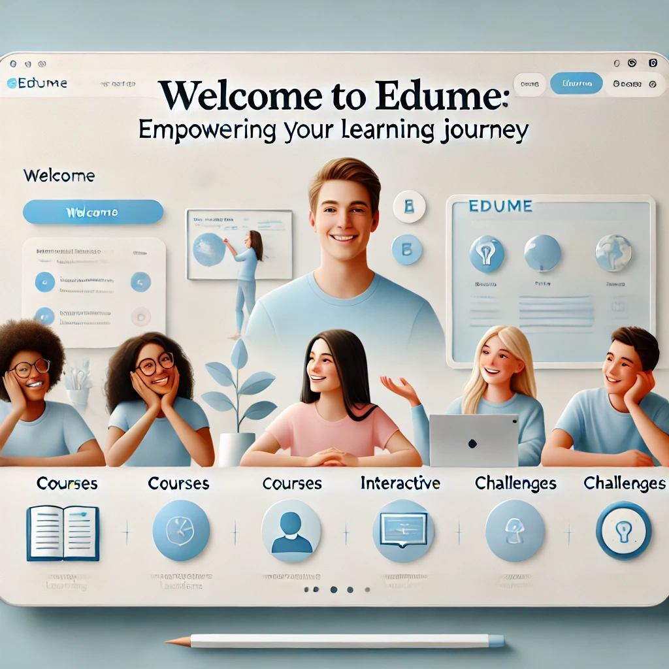
INTRODUCTION
Welcome to eduMe: Empowering Your Learning Journey
At eduMe, we believe that education should be accessible, interactive, and personalized to meet your unique learning goals. Our platform is designed to provide learners of all levels with the tools and resources they need to excel in a wide range of subjects. Whether you're mastering new skills, preparing for exams, or deepening your knowledge in your field of interest, eduMe is here to guide you every step of the way.
With expert-led courses, interactive lessons,and
practical challenges, you'll not only learn
but also apply what you've learned in
real-world scenarios. Join a community of
passionate learners, and let's embark
on a journey of growth and success—together.

Slide 4
Software/ Hardwork Requirements
Software requirements:
Frontend:
React.js: A JavaScript library for building user interfaces.
React Router: For handling routing in the application.
Tailwind CSS (or any CSS framework): For styling the application.
Backend:
Node.js: JavaScript runtime for server-side development.
Express.js: Web framework for Node.js to build APIs.
MongoDB: NoSQL database for data storage.
Development Tools:
Code Editor: Visual Studio Code (or any preferred IDE).
Postman: For testing API endpoints.
Git: Version control system for managing codebase.
npm: Package managers for managing project dependencies.

Slide 5
Software/ Hardwork Requirements
Hardware requirements:
For development:
Processor: Intel Core i5 or equivalent (or higher).
RAM: Minimum 8 GB (16 GB recommended for smooth performance).
Storage: At least 256 GB SSD for faster read/write speeds.
Operating System: Windows 10/11, macOS, or a Linux distribution.
For Users:
Device: Desktop computer, laptop, or tablet.
Processor: Intel Core i3 or equivalent (or higher).
RAM: Minimum 4 GB (8 GB recommended for optimal performance).
Internet Connection: Stable broadband connection (for video consultations).

Slide 6
Feasibility Study
The feasibility study for eduMe evaluates the platform’s potential to offer accessible, interactive learning to a broad audience. With increasing demand for online education, eduMe leverages scalable technology, expert content, and a user-friendly interface to meet learners' needs.
Technical Feasibility :-
Technology Stack:
MongoDB: NoSQL database for flexible data storage.
Express.js: Backend framework for building APIs.
React: Frontend library for building user interfaces.
Node.js: Server environment for handling requests.
Operational Feasibility :-
Resources Required:
Development tools (IDE, version control).
Hosting services (AWS, Heroku).

Slide 7
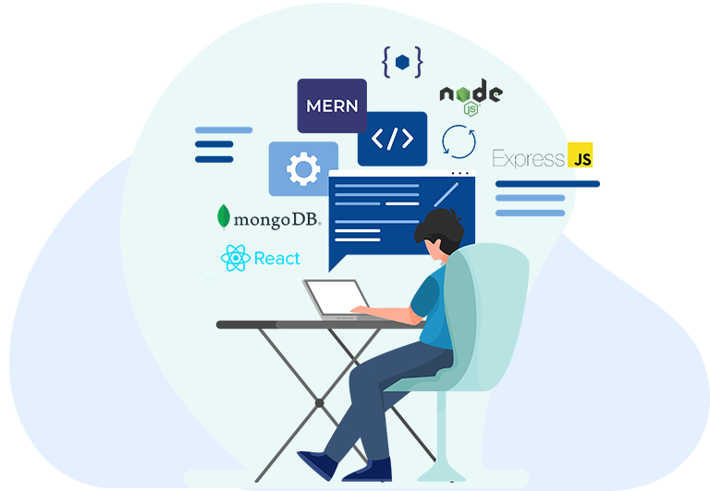
Feasibility Study
Financial Feasibility :-
Cost Estimates:
Costs for development tools, hosting, and services (e.g., MongoDB Atlas).
Basic features for free, premium features available via subscription.
Long-term financial stability can be ensured through user growth, exploring new markets, and diversifying course offerings.

Slide 8
Techniques and Tools Used
In developing the eduMe-Learning Website telemedicine platform, a variety of techniques and tools were employed to ensure a robust, efficient, and user-friendly application. The following outlines the primary technologies and methodologies utilized throughout the project:
Development techniques
Agile Methodology: Implement an iterative development process with regular sprints to adapt to changing requirements.
Version Control: Use Git for source code management, enabling collaboration among team members.
RESTful API Design: Create structured APIs for communication between the frontend and backend, ensuring clean separation of concerns.
Component-Based Architecture: Utilize React’s component-based structure for reusable UI components, improving maintainability and scalability.

Slide 9
Techniques and Tools Used
User Engagement techniques
Push Notifications: Implement push notifications to keep users engaged with reminders, tips, and motivational messages.
Security techniques
Data Encryption: Encrypt sensitive user data both at rest and in transit using protocols like HTTPS and tools like bcrypt for password hashing.
Authentication and Authorization: Implement JWT (JSON Web Tokens) for secure user authentication and role-based access control.

Slide 10

Design
The design of eduMe- Learning Website encompasses both the architectural design of the application and the user interface design.
Architectural Design
Client-Server Architecture: The application is structured using a client-server architecture where the frontend (React) communicates with the backend (Node.js and Express) via RESTful APIs.
Database Layer: MongoDB serves as the database layer to store user, courses, lessons, quizzes, performance , and review information.

Slide 11
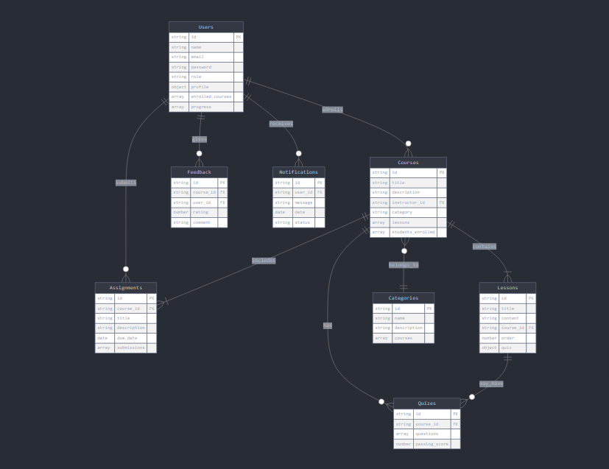
Entity-Relationship Diagram

Slide 12
results
System Functionality :-
User Management:
Allow users to create new accounts with name, email, and password. Support password reset and recovery. Enable users to update their bio and other personal information. Enable users to update their bio and other personal information.
Course Management:
Create new courses with title, description, and category. Track completed lessons and overall course progress. Allow students to enroll in courses. Set course order within a category.
Lesson Management:
Add lessons to courses with title and content. Set lesson order within a course. Allow students to access and view lesson content. Mark lessons as completed.
Quiz System :
Create quizzes for courses or individual lessons . Add multiple-choice questions with options and correct answers Provide immediate feedback on quiz performance. Automatically grade quizzes based on correct answers

Slide 13
results
Feedback and Rating System:
Course Feedback : Allow students to provide ratings and comments for courses
Feedback Analysis: Aggregate and display course ratings. Show instructor performance based on course feedback.
Security Measures :
Data Protection :
Implemented robust security measures, including JWT-based authentication for secure user sessions and encrypted storage for sensitive user information.
The results demonstrate that the eduMe platform effectively meets its objectives by providing a comprehensive solution for online learning and education. The successful integration of core functionalities, combined with positive user feedback and strong performance metrics, validates the design and implementation choices made throughout the project.

Slide 14
Conclusion
The eduMe- Learning Website project successfully addresses the growing need for accessible healthcare services through a user-friendly telemedicine platform. User feedback indicates high satisfaction among both students and instructors, with metrics showing strong engagement and course completion rates. The platform's success is evident in its growing user base and positive performance indicators.
Key Achievements:
Comprehensive User Management: The platform's robust user registration, authentication, and profile management systems ensure a personalized and secure experience for both students and instructors.
Efficient Course and Lesson Management: The intuitive course creation, enrollment, and progress tracking features have streamlined the learning process, making it easier for instructors to deliver content and for students to engage with it.
Interactive Learning Tools: The integration of quizzes, assignments, and immediate feedback mechanisms has enhanced the learning experience, promoting active engagement and knowledge retention.
Personalized Learning Paths: The system's ability to track individual progress and provide tailored notifications has supported adaptive learning, allowing students to learn at their own pace.
Community and Feedback: The implementation of a course rating and feedback system has fostered a sense of community and continuous improvement, benefiting both students and instructors.
Scalable Content Organization: The category management and search functionality have made it easy for users to discover relevant courses, supporting the platform's growth and diversity of offerings.

